Slide 1

Jaga Mission
Participatory
Slum Upgradation &
De-Notification
ULB Reviews
<Name of ULB>, District
<Name of Presenter, Designation>
<Date of presentation>
urbanodisha.gov.in @HUDDeptOdisha

Slide 2
IMPORTANT THIS PPT IS A TEMPLATE TO MAKE PRESENTATION TO HUDD PS and DMA ON JAGA MISSION SAVE THE FILE WITH YOUR ULB NAME EDIT THE TEMPLATE – REMOVE THIS SLIDE EACH SLIDE HAS INFORMATION TO BE FILLED ADD ADDITIONAL SLIDES AS NECESSARY EACH PRESENTATION IS 2-3 MINUTES

Slide 3
AGENDA
Overview of slum situation
Ward wise slum details
Challenges
ULB Core Team
Training Plan
Goals for Utkal Diwas
*Note all work needs to be completed by 28th February 2021, and delisting needs to be initiated by 1st week of March 2021 and the date of completion will be 15th March,2021

Slide 4
Overview of Slums in <ULB Name>
Population (2011): Population in slums :
Number of wards :
Number of ward officers :
(if 2 or 3 wards have one ward officer, count it as 1)
Number of Slums :
Total no of Slum House holds :
Total Slum Population :
Tenable slums:
Number of active SDAs :
Slums with Parichaya (MAC) :
Community Centers:

Slide 5
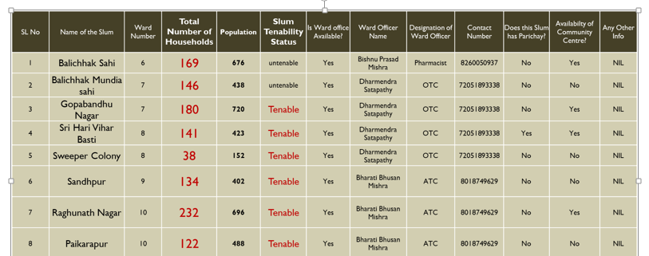
<ULB NAME> WARD LEVEL SLUM DETAILS
INSERT XL HERE (XL TEMPLATE AVAILABLE)

Slide 6
<ULB> ULB Core Team
<List names of ULB Core Team below and remove this>
EO <name>
Municipal Engineer <name>
Community Organizers <names>
Sanitation Expert <name>
CMMU <name>
Assistant Engineer <name>
Assistant Engineer PHEO <name>
Junior Engineer <name>
Concerned Ward Officers <whichever wards have slums >
Jaga/SUDN Co-ordinators <if any>

Slide 7
Training Plan
ULB Capacity Building Training
Date :
Venue :
Names of Master Trainers :
SDA Capacity Building Training
Wards, Dates, Venues

Slide 8
<ULB> Our targets for Utkal Diwas 2021
We plan to complete the work before 28th February 2021 for the following slums
Major work involved
List of slums
The following slums will be ready for de-notification before September 2021 towards first year target
Major work involved
List of slums

Slide 9
<ULB> Challenges
List any issues or challenges that need to be addressed here

Slide 10
THANK YOU

