Slide 1
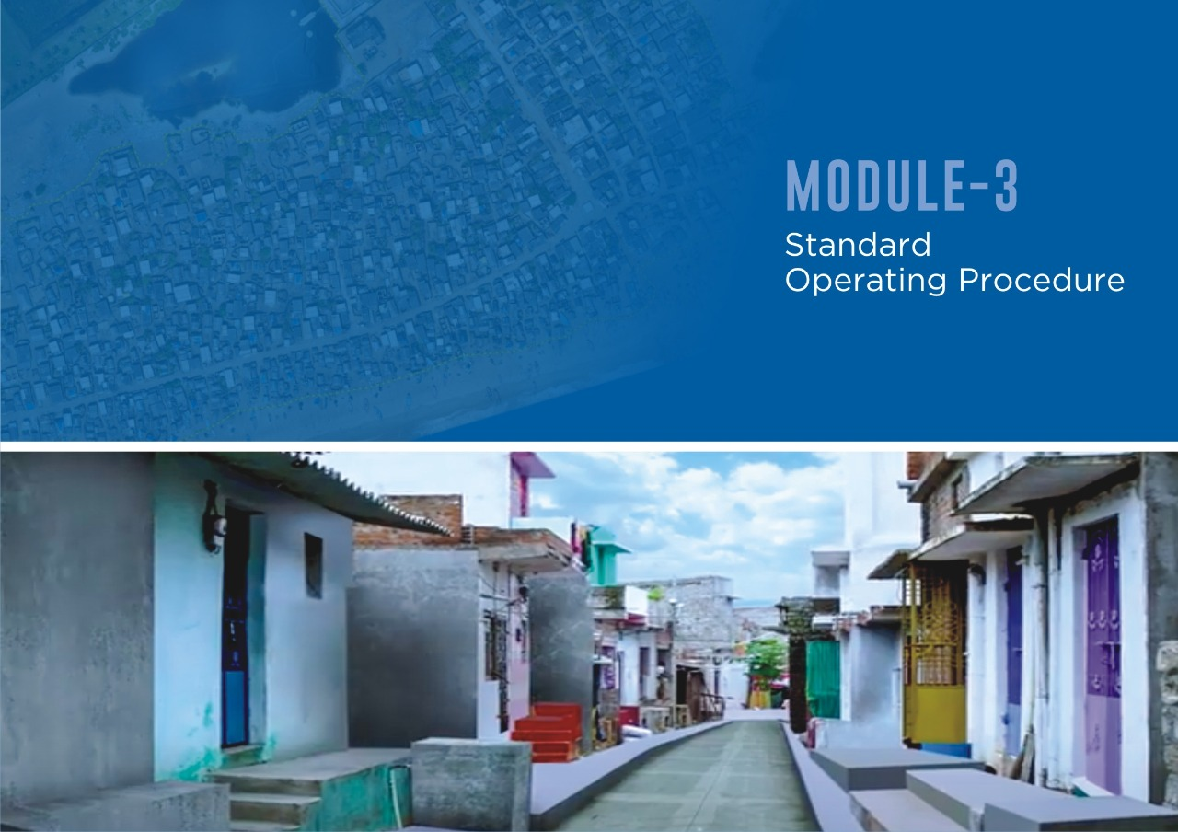

Slide 2




LAUNCHED ON 28TH SEPTEMBER 2020 BY HONORABLE CM
01

Slide 3


STANDARD OPERATING PROCEDURE
OBJECTIVE OF THE STANDARD OPERATING PROCEDURE
A
Identification and Listing of slumsª
To have a bench-marking in taking up the slum infrastructure upgradation
B
Undertake Participatory Infrasturcture Needs Assessment (PNA)^{b} at slum level for primary infrastructure facilities
Why are these procedures required
C
Prepare I-GAP^{c} to assess the infrastructure gap
In “All Municipal Corporations” Municipalities and Notified Area Councils (NACs) in Odisha
at slum level and to plan for slum upgradation projects
Slums requiring intervention
Who all will be covered
D
Execution of slum upgradation projects
Slum with adequate infrastructure
Who will anchor this work
Ward Officer
E
Completion of slum upgradation projects
Not
Delisting Proposal^{d} submitted by SDA/RWA for evaluation by ULB
recommended
F
G
Delisting procedure^{e,f}
H
Renaming of the habitation (if agreed by SDA/RWA) and incorporation in the ULB and other records^{g}
02

Slide 4

Step A. IDENTIFICATION AND LISTING OF SLUMS
A Identification and Listing of slumsª
B
Undertake Participatory Infrasturcture Needs Assessment (PNA)^{b} at slum level for primary infrastructure facilities
C
Prepare I-GAP^{c} to assess the infrastructure gap
at slum level and to plan for slum upgradation projects
Slums requiring intervention
ULBs to identify all the slums within its jurisdiction based on the the definition under section 2(r) of the LR Act, 2017
D
Execution of slum upgradation projects
Slum with adequate infrastructure
E Completion of slum upgradation projects
Format for maintain a list of all slums to be maintained by the ULB as per Annexure 1 of SOP
Not
Delisting Proposal^{d} submitted by SDA/RWA for evaluation by ULB
recommended
F
G
Delisting procedure^{e,f}
H
Renaming of the habitation (if agreed by SDA/RWA) and incorporation in the ULB and other records^{g}
03

Slide 5
Step B. UNDERTAKE NEED ASSESSMENT (PNA)
A
Identification and Listing of slumsª
Periodic slum level Participatory Infrastructure Needs
Assessment (PNA) shall be undertaken by the concerned Ward officer on behalf of ULBs/ SDAs/ RWA .
The PNA will cover the status of access to the primary infrastructure through survey and Group discussions with SDA/ RWA specifically - Water supply, Pucca roads, Pucca storm water drainage, Street lights, Access to toilet facilities and electricity supply.
The concerned Ward Officer shall undertake the assessment together with SDA, through field visits and discussions with the residents. He/ she shall be the Nodal officer for PNA and will be supported by team deputized by the
B
Undertake Participatory Infrasturcture Needs Assessment (PNA)^{b} at slum level for primary infrastructure facilities
C
Prepare I-GAP^{c} to assess the infrastructure gap
at slum level and to plan for slum upgradation projects
Slums requiring intervention
D
Execution of slum upgradation projects
Slum with adequate infrastructure
E Completion of slum upgradation projects
Not
Delisting Proposal^{d} submitted by SDA/RWA for evaluation by ULB
recommended
F
ULB.
G
Delisting procedure^{e,f}
Format for capturing slum level data is enclosed as
Annexure 2 of SOP
H
Renaming of the habitation (if agreed by SDA/RWA) and incorporation in the ULB and other records^{g}
04

Slide 6
Step C: PREPARE GAP ANALYSIS (I-GAP)
A
Identification and Listing of slumsª
B
Undertake Participatory Infrasturcture Needs Assessment (PNA)^{b} at slum level for primary infrastructure facilities
C
Prepare I-GAP^{c} to assess the infrastructure gap
I-GAP tool will be used to assess the vulnerability of
slums based on availability of primary infrastructure
If any slum is identified with adequate infrastructure as per I-GAP, the slum may directly be taken up for delisting.
Based on the identified infrastructure gaps, the concerned Ward Officer on behalf of ULB will initiate the preparation for upgrading slum level infrastructure.
at slum level and to plan for slum upgradation projects
Slums requiring intervention
D
Execution of slum upgradation projects
Slum with adequate infrastructure
E Completion of slum upgradation projects
Not
Delisting Proposal^{d} submitted by SDA/RWA for evaluation by ULB
recommended
F
G
Delisting procedure^{e,f}
H
Renaming of the habitation (if agreed by SDA/RWA) and incorporation in the ULB and other records^{g}
05

Slide 7
Step D & E: EXECUTION AND COMPLETION OF PROJECTS
A Identification and Listing of slumsª
B
Undertake Participatory Infrasturcture Needs Assessment (PNA)^{b} at slum level for primary infrastructure facilities
Execution:
The slum upgradation projects shall be executed under the supervision of the Ward Officer and SDA/RWA will be the Implementation Partner.
The details of the execution modalities of slum upgradation projects and involvement of IP will be shared by the State Government from time to time.
Completion:
The Ward Officer on behalf of ULB, shall ensure the completion of the slum upgradation projects
C
Prepare I-GAP^{c} to assess the infrastructure gap
at slum level and to plan for slum upgradation projects
Slums requiring intervention
D
Execution of slum upgradation projects
Slum with adequate infrastructure
E Completion of slum upgradation projects
Not
Delisting Proposal^{d} submitted by SDA/RWA for evaluation by ULB
recommended
F
G
Delisting procedure^{e,f}
H
Renaming of the habitation (if agreed by SDA/RWA) and incorporation in the ULB and other records^{g}
06

Slide 8
Step F: DELISTING PROPOSAL
A Identification and Listing of slumsª
B
Undertake Participatory Infrasturcture Needs Assessment (PNA)^{b} at slum level for primary infrastructure facilities
The SDA/RWA will submit the respective Proposal for delisting the concerned slum of evaluation the ULB.
The ULB shall evaluate the delisting proposal based on six primary infrastructure facilities as per Annexure 4
The ULB may undertake the evaluation either based on field level verification or its observations or a combination of both. The proposal will then be passed by a Council resolution.
Subsequently, the same may be forwarded UASRRC for delisting.
C
Prepare I-GAP^{c} to assess the infrastructure gap
at slum level and to plan for slum upgradation projects
Slums requiring intervention
D
Execution of slum upgradation projects
Slum with adequate infrastructure
E Completion of slum upgradation projects
Not
Delisting Proposal^{d} submitted by SDA/RWA for evaluation by ULB
recommended
F
G
Delisting procedure^{e,f}
H
Renaming of the habitation (if agreed by SDA/RWA) and incorporation in the ULB and other records^{g}
07

Slide 9
Step G: DELISTING PROCEDURE
A Identification and Listing of slumsª
UASRRC shall constitute a Delisting Scrutiny Sub- Committee to validate the slum delisting recommendation
DSC based on its observations, may refer to the SDA/RWA and ULB through UASRRC for attaining adequate level of infrastructure works in the slums (or) may validate the process of delisting, as the case may be.
UASRRC will issue a public notice inviting objections to the change of status of the slum with in a period of 15 days. Upon redressing of the objections(if any), it will direct the concerned ULB to issue an order for delisting of the slums, as per Annexure 5 of the SOP
And as per Annexure 6, the concerned SDA will pass a resolution converting the SDA to RWA with an intimation to ULB through the concerned ward officer
B
Undertake Participatory Infrasturcture Needs Assessment (PNA)^{b} at slum level for primary infrastructure facilities
C
Prepare I-GAP^{c} to assess the infrastructure gap
at slum level and to plan for slum upgradation projects
Slums requiring intervention
D
Execution of slum upgradation projects
Slum with adequate infrastructure
E
Completion of slum upgradation projects
Not
Delisting Proposal^{d} submitted by SDA/RWA for evaluation by ULB
recommended
F
G
Delisting procedure^{e,f}
H
Renaming of the habitation (if agreed by SDA/RWA) and incorporation in the ULB and other records^{g}
08

Slide 10
Step H : RENAMING OF THE HABITATION
A
Identification and Listing of slumsª
B
Undertake Participatory Infrasturcture Needs Assessment (PNA)^{b} at slum level for primary infrastructure facilities
Prepare I-GAP^{c} to assess the infrastructure gap
Upon formal delisting of the slum the ULB, RWA may seek to change the name through a resolution as per Annexure 7
The ULB through the concerned Ward Officer shall take following actions for incorporation of changed name:
Necessary corrections in the ULB and other records,
Publication of change of name in the local newspaper
Gazette notification will be made to the effect and
Intimation to the postal authorities informing the changes.
C
at slum level and to plan for slum upgradation projects
Slums requiring intervention
D
Execution of slum upgradation projects
Slum with adequate infrastructure
E Completion of slum upgradation projects
Not
Delisting Proposal^{d} submitted by SDA/RWA for evaluation by ULB
recommended
F
G
Delisting procedure^{e,f}
H
Renaming of the habitation (if agreed by SDA/RWA) and incorporation in the ULB and other records^{g}
09

Slide 11
ANNEXURE 1 – List of Slums in the Urban Local Body (ULB)
Annexure 1
List of slums in the Urban Local Body
District Name:..................................................................... ULB Name...........................................................................
Sl. No. | Ward Number | Slum Name | Location with Geo-Coordinates | Approx. Year of Formation | Land Classification & Ownership information | Total Number of Household | Date | Remarks, if any
10

Slide 12
ANNEXURE 2 – Format for Participatory Infrastructure Needs Assessment (PNA)
Annexure 2
Format for Participatory Infrastructure Needs Assessment (PINA)
(This format will be used to conduct a Participatory Infrastructure Needs Assessment (PINA) in all the slums of the ULB.)
Table 2 : Primary infrastructure facilities in the slum
A. WATER SUPPLY
1. Is piped water supply available at the slum street level? (inside slum area) [YES/NO] If NO, move to Q3
2. Dwelling units with a water supply pipeline at the street level | Number: | Percentage:
3. Which is the primary source (if No in Q1)/supplementary source (if Yes in Q1) of potable water supply for residents? (Public tap – 01; Tube well – 02; Open well – 03; Pond/river/canal – 03; Bore well – 04; other – 05) | Remarks:
B. PUCCA ROADS
4. Dwelling Units having access to public road/street (within slum) | Number: | Percentage:
5. Length of inner pucca road/streets (in Km) | Length: | Percentage:
C. PUCCA STORM WATER DRAINAGE
6. Dwelling Units connected/discharging to pucca drains | Number: | Percentage:
D. STREET LIGHTS
7. Functional street lights | Number: | Percentage:
8. Street length covered by functional street lights (in Km) | Length: | Percentage:
E. ACCESS TO TOILET FACILITY
9. Dwelling units with septic tank/pit/sewer system and functional IHHL | Length: | Percentage:
10. No of HHs having access to toilets (IHHL+CT/PT) | Length: | Percentage:
11. No. of community toilets
12. No. of seats available in community toilets
F. IN-HOUSE ELECTRICITY
13. Dwelling units having individual authorised electricity connection | Number: | Percentage:
District Name………………………… ULB Name……………………………….
1. Objective:
Preparing a baseline of slum information & infrastructure gap
Basis for preparing Slum Upgrading Plans
2. Methods to be used:
Group Discussion: At least 2 Group Discussions in each slum
Team Composition:
(wherever available)
Discussion Pointers for conducting Group Discussion
Table 1 : General information about the slum
A. GENERAL PROFILE
1. Ward No.
2. Slum name as per ULB record
3. Slum name as per local community (if different from the ULB record)
4. Total no. of slum households
5. Total inner road/ street length in the slum (in km)
B. DWELLING UNIT TYPE
6. Total no of Dwelling Units
7. No. of Pucca houses
8. No. of Semi-Pucca houses
9. No. of Kutchha houses
Table 3 : Solid waste disposal facilities in the slum
SOLID WASTE DISPOSAL
Door-to-door collection of garbage and road cleaning taking place (Yes/No)
11

Slide 13

ANNEXURE 3 – Framework for Preparing I-GAP (Infrastructure Gap Assessment Profile) at Slum Level
Annexure 3 Framework for preparing
A. Water Supply
% of HHs with water supply pipeline in the Street = (No. of HHs having access to water supply pipeline in the street/Total no. of households) x 100
(Data Source: Q2, Table 2 in Annexure 2)
Percentages (%)
Introduction
I-GAP is a decision-making tool for the ULB to objectively strategize the intervention in slums. This assessment has to be done for all the slums listed as per Annexure 1, drawing on the data from Annexure 2. This document will be the basis for identifying primary infrastructural gaps which require upgradation, before a slum settlement is taken
B. Pucca Road
% of total pucca road length = (Total pucca road length/Total road length) x100
(Data Source: Q5, Table 2 in Annexure 2)
his/her jurisdiction by displaying the same at the slum level. This tool will be useful:
To assess the infrastructure gap at the slum level and help the ULB in developing an informed multipronged and phasing strategy for delisting.
To plan for slum upgradation projects addressing the gaps.
C. Pucca Storm Water Drainage
% coverage of pucca drains = (No of HHs connected/ discharging to pucca drains /Total no. of households) x 100
(Data Source: Q6, Table 2 in Annexure 2)
iii. Summary of Slum I-GAP scores at the City Level
A summary of all the slum scores is drawn out (Table 3) for comparing the scores across all the slums in the city. This table will identify slums with a score greater than or equal to 80% across the six primary infrastructure facilities which may be prioritized for delisting.
D. Streetlights
% of street length with functional street lights = (Length of street with functional street light/Total internal street length) x100
(Data Source: Q7, 8, Table 2 in Annexure 2)
E. Access to Toilet Facilities
% of HHs having access to safe functional toilet = {(No. of HHs with IHHL for exclusive use+ no of HHs having access to CT/PT) /total number of households in the slum} x 100
(Data Source: Q9,10, Table 2 in Annexure 2)
Table 3: Summary of Slum IGAP scores at the City level
Slum Name | Ward Number | Total Slum level score (Average of percentages of coverage of the six primary infrastructure facilities - Refer to Table 2) | if any (if the slum level score is =80% then Y, else N)
Slum 1
Slum 2
Slum 3
Slum 4
Slum 5
Slum 6
F. In-house Electricity
% of households having individual authorised electricity connection = (number of HHs with authorised electricity connections /the total number of households in the slum) x 100.
(Data Source: Q13, Table 2 in Annexure 2)
Total slum score (Average of percentage of coverage of six primary infrastructure facilities)
12

Slide 14
ANNEXURE 4 – Proposal for Delisting of Slum
Annexure 4
PROPOSAL FOR DELISTING OF SLUM
District Name……………………………. ULB Name………………………….
Submitted to:
Observations by Commissioner/ E.O. of Municipal Corporation/Municipality/ NAC:
Sl. No. | Infrastructure facilities | Before Upgradation based on I-GAP in % (refer Annexure 3) | After upgradation
a. | Water Supply
b. | Pucca Roads
c. | Pucca Storm Water Drainage
d. | Street lights
e. | Access to Toilets facilities
f. | In-house electricity
Slum Name :
Location :
Number of Households :
Infrastructure Facilities: (tick option)
Sl. No. | Parameters | Participatory Infrastructure Needs Assessment Conducted | Slum upgrading projects Completed
4.1 | Water Supply | Yes No | Yes No NA
4.2 | Pucca Roads | Yes No | Yes No NA
4.3 | Pucca Storm Water Drainage | Yes No | Yes No NA
4.4 | Street lights | Yes No | Yes No NA
4.5 | Access to toilets facilities | Yes No | Yes No NA
4.6 | In-house electricity | Yes No | Yes No NA
Based on the
of the primary infrastructure on the abovementioned parameters, by the Municipal Corporation/ Municipality/ NAC, (slum name) in Ward Number has
Pursuant to Municipal Corporation/ Municipality/ NAC Council Resolution No. /2020 dated attached of Annexure B) the (slum name) is recommended/not recommended for delisting.
(Copy
Submitted to:
Observations by DSC Constituted under UASRRC:
Recommended/Not Recommended
(Chairperson)
Signatures & designation of all other members of DSC:
(Member) (Member)
(Member Convenor)
(Member) (Member)
CONCLUSION
Based on assessment of primary infrastructure by SDA/ RWA on the abovementioned parameters, the members of (slum name) SDA/RWA unanimously resolve to pass a resolution proposing the de-listing of the
(slum name). The framework for resolution has been placed at Annexure A.
Recommended/Not Recommended
President
____SDA/RWA
Secretary
___SDA/RWA
Treasurer
____SDA/RWA
Signature of the Collector
13

Slide 15
ANNEXURE 7 – Renaming of Slum
Annexure 7
PROCEEDINGS OF THE MEETING OF THE EXECUTIVE COMMITTEE OF SDA/ RWA FOR CHANGING NAME OF 'ERSTWHILE' SLUM
List and Signature of members in the meeting
Sl. No. | Name of the Member | Designation | Signature/Thumb Impression
 |  | President
 |  | Treasurer
 |  | Member
 |  | Member
 |  | Member
 |  | Member
 |  | Member
District……………………….... ULB…………...…………….. Slum…………………………………......
Date & Time: ; AM/PM Place:
A meeting was organised under the Chairpersonship of Ms. /Mr. ……………………….. to discuss the proposal for change of name of slum earlier known as to in Ward No: under Municipal Corporation/Municipality/NAC. The list of members present in the meeting with their signatures/thumb
impressions is attached. The following points were discussed and resolution was passed:
Resolution: / 2020
Pursuant to the delisting /2020; dated issued by
Enclosed as above
Municipal
issued
Copy for kind information and necessary action, submitted to:
Municipal Corporation/Municipality/NAC
Postal Department
Revenue Department
District Town Planning and
Concerned Urban Development Authority
Corporation/Municipality/NAC along with the conversion of SDA to RWA via Res /2020 dated
by SDA now will be changed to
RWA, the members present discussed and resolved that the name of the SLUM/RWA
.
We, all members hereby agree to the above decision.
14

Slide 16


