Slide 2
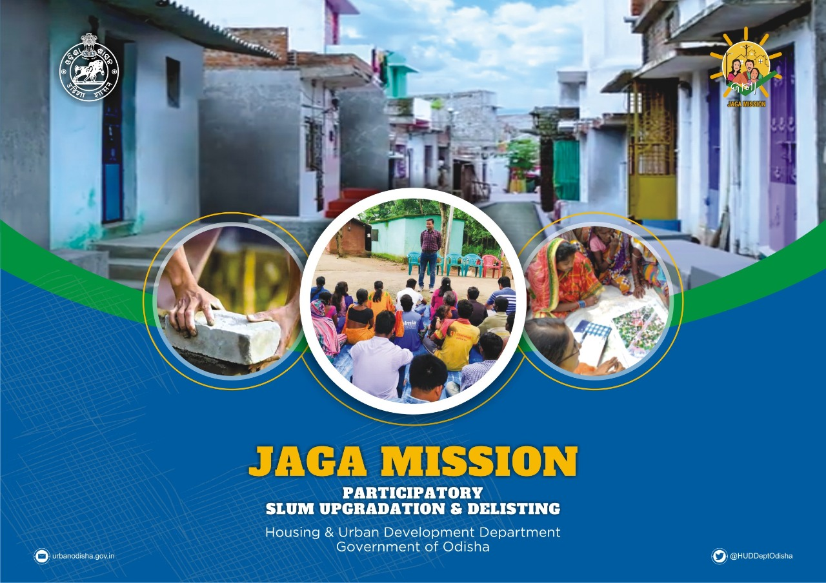

Slide 3
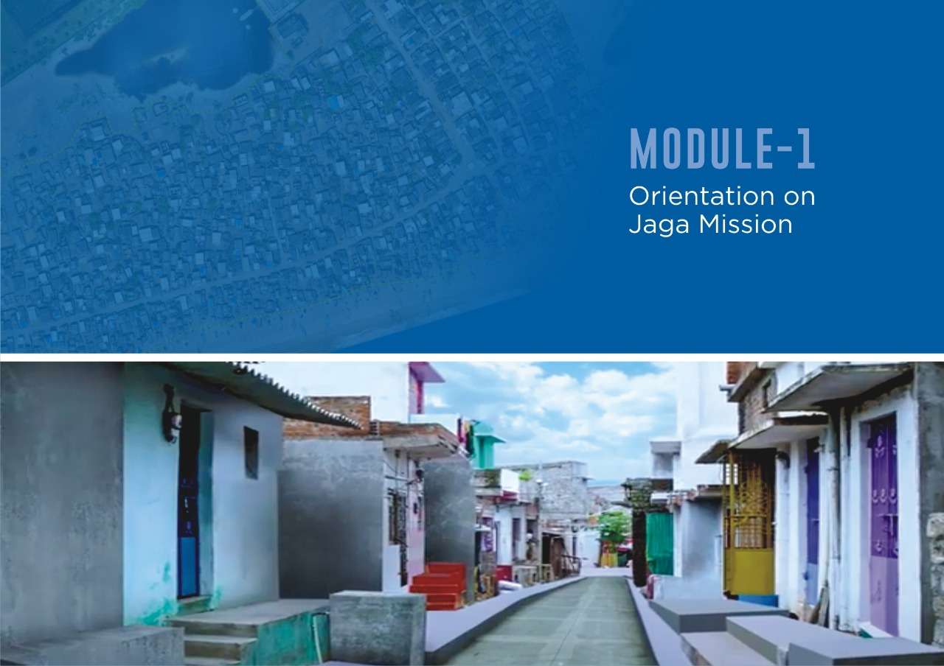

Slide 4



Lets get to know each other
Briefly introduce yourselves.
Tell us what you expect to learn from the exercise today.
01

Slide 5




What we expect to do in the next three hours
02

Slide 6

Training Objectives
Module 1 : Orientation to JAGA Mission
1.
2.
3.
Introduce the vision and objectives of JAGA Mission - I & II. Discuss key aspects of the JAGA Mission – II.
Understand role of different stakeholders in its execution.
Module 2 : Slum Governance Understand :
Understand how the government works​
Understanding relevance and importance of SDAs​
Discuss how and why participation of SDAs is essential in making this project a reality​
Learn how to train SDAs with necessary skill set needed in order to work along with ULB core teams
03

Slide 7
Training Objectives
Module 3 : Standard Operating Procedure (SOP)
Objective and coverage
Identification and listing of the Slums
Infrastructure Assessment
Gap Analysis
Operational Guidelines
Delisting Proposal, Procedures and Re-naming
05

Slide 8

JAGA MISSION I
•Vision and objectives (CM’s video)
•Accomplishments
06

Slide 9
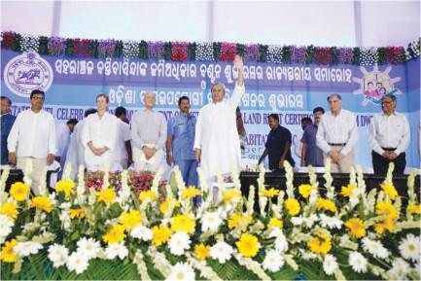
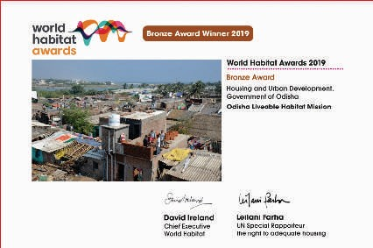
JAGA Mission – The journey and the legacy
•The Govt. of Odisha launched JAGA Mission – the world’s largest slum titling and upgradation initiative – in May 2018 with the aim of granting land rights to slum dwellers in the state and transforming slums to liveable habitats.
•JAGA Mission covers all 2919 slums in 114 Urban Local Bodies (ULBs) of Odisha with coverage of 1.8 million slum dwellers.
•JAGA Mission received international acclaim and was awarded the prestigious ‘World Habitat Award’ in December 2019
•JAGA Mission is now moving to its next stage of transforming slums to liveable habitats through a comprehensive slum upgrading process.
07

Slide 10
Overview
“JAGA “ was launched under the Odisha Liveable Habitat Mission launched in 2017 by the Government of Odisha by Honourable Chief Minister Shri Naveen Patnaik.
To provide land-rights to urban poor in cities and towns.
08

Slide 11
Accomplishments
•Distributed Land Rights Certificates to over 60000 families and Land Entitlement Certificates to over 105000 families
•106 Urban Area Slum Redevelopment and Rehabilitation Committees formed across the state
•Completed formation of Slum Dwellers Association
•Conducted drone mapping of slums across state
09

Slide 12

JAGA MISSION II
1.
Introduce the vision and objectives of JAGA Mission - I & II.
Discuss key aspects of the JAGA Mission – II. Understand role of different stakeholders in its
execution.
2.
3.
10

Slide 13
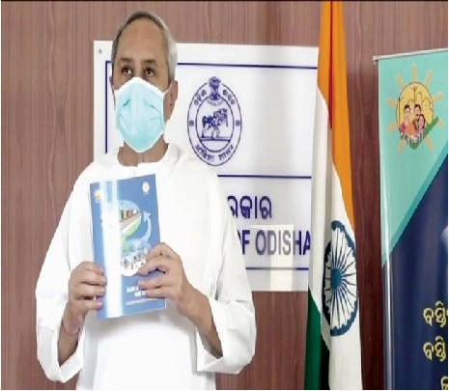


Launched on 28th September 2020 by honorable CM
11

Slide 14
JAGA MISSION II - OBJECTIVES
Onboarding ULBs and formation of core teams across the state
Training 'master trainers' from ULB core teams who will aid in capacity building in selected tenable slums across 16 ULBs and 532 slums
Strengthening SDAs by equipping them with the knowledge and tools to participate in phase 2 of Jaga Mission
ULB core teams and SDAs to collectively carry out Participatory Infrastructure Needs Assesment
Operationalise upgradation of slum infrastructure along with ULB core teams
Call for resolution from SDAs to ensure work is completed as per their expectations
Submit for delisting once upgradation is complete
12

Slide 15



Partners
13

Slide 16

Objective
•Integrate slums into mainstream city
•Work in six verticals - Water, Electricity, Road, Drain, Toilet, Street Lights must be completed in these slums to delist prior to 1st March 2021
•Target set by Hon’ble Chief Minister 1000 slums in the first year
•Target set for Utkal Diwas April 1st 2021 : De-notify 581slums to become Adarsh colonies
•3 ULBs identified as pilots : Dhenkanal, Jatni and Khurda
•16 ULBs identified as high potential for De-Notification till 1st April 2021
14

Slide 17

SLUM UPGRADATION- TARGET
2919 slums to be transformed into “Adarsh Colony” in 3 years.
Target till March 2021: 581 Slums.
The 1st Phase of target Slums in Municipalities and NACs are selected based on the Tenability Status and Slums in Municipal Corporations are selected in consultation with the Officials at ULB.
15

Slide 18

SLUM UPGRADATION- THE SIX COMPONENTS
Piped Water Supply
Pucca Road
Street Lighting
Access to Toilet facility (IHHL, CT/PT)
Pucca Storm Water Drainage
In-house Electricity
16

Slide 19
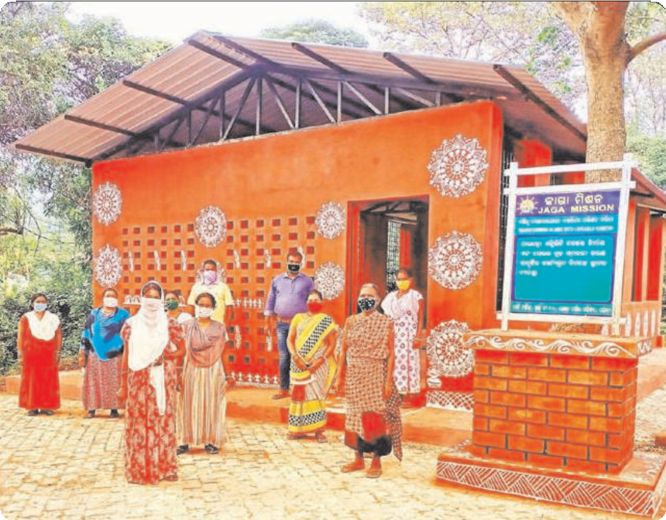


Parichay becomes the nerve center for slum upgradation where community meets.
Trainings and group discussions are held, and it houses all
on-going information about projects, status, costs
Celebrate Change – via Before and After photos
17

Slide 20


Countdown to Utkal Divas 2021…
November 2020 - March 2021
Identify slums for Fast Track
Target 25
Execution complete by March 2021
Delisting process complete before March 15th 2021
Identify slums where in-situ dev can happen
Plan for each ULB
Designate core team
Train core team as master trainers
Capacity Building for SDA
PNA
IGAP results
Dhenkanal (23)
Jatni (7)
Khurda (15)
To be completed
by Oct 31st
November 12th - 20th
November 15th - 30th
November 15th - 25th
Part of 1000 for first year
SCALE UP
TO 109 ULBS
18

Slide 21
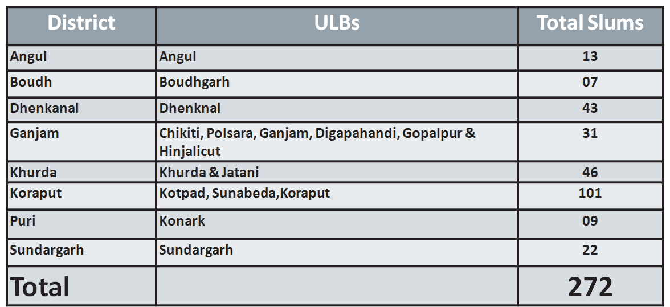

Phase 1- Targets for Municipalities & NACs (16 No)
19

Slide 22


Phase 1- Targets for Municipal Corporations (3 No)
District | ULBs | Total Slums Proposed
Cuttack | Cuttack Municipal Corporation | 143
Ganjam | Berhampur Municipal Corporation | 50
Kurda | Bhubaneswar Municipal Corporation | 116
Total |  | 309
20

